Slide 1
STA130 T0209
Week 3
(Materials used in this presentation are provided by the U of T Statistical Sciences Department.
This presentation was prepared by Vivian Ngo.)

Slide 2
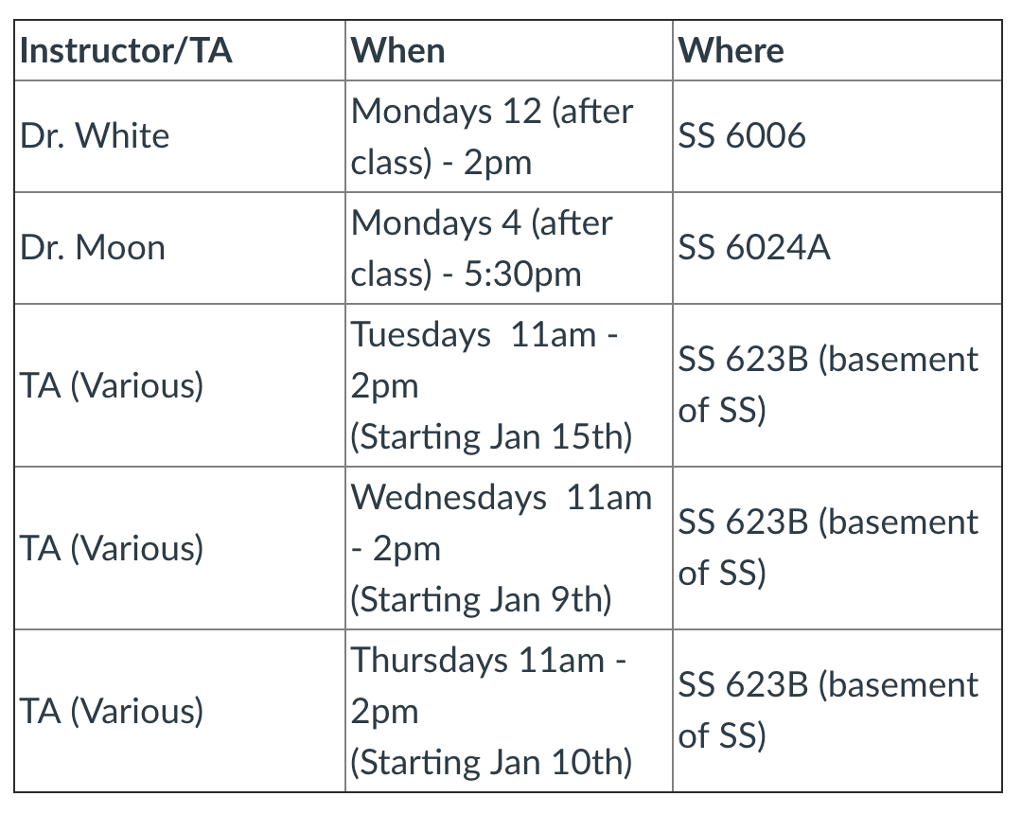
Reminders
Homework: incomplete or late = 0
Corrupted files
Email policy
Office hours, TA hours, Piazza
Tutorial: 10 minutes after the hour
Missing tutorials
Writing assignments
Include graphs
Title your graphs
Concise
Value added

Slide 3
Agenda
Vocabulary
Boxplots
Homework discussion
Writing activity
Second half: Meeting mentors

Slide 4
Vocabulary
General terms:
Outlier
Interquartile range
Boxplot
Proportion
Terms for describing data wrangling:
Cleaning data
Tidy data
Create a dummy variable
Removing the column
Replace values above/below a certain threshold
Taking the subset of variables
Filtering the data frame based on a condition (e.g. based on one of the variables/columns)
Renaming the variables
Grouping the categories

Slide 5
Boxplots
When to use?
What information do they display?

Slide 6
Homework discussion
For Question 1D, you used both histograms and boxplots to visualize your data.
Which features were easier/harder to observe from each of the visualizations?
In what situations may you want to choose a boxplot over a histogram, or vice versa? Explain.

Slide 7
Writing activity
Self-Reflection:
What questions, if any, do you have so far regarding the course materials?
What is one of your favorite things about tutorial? Least favorite?

